Slide 1
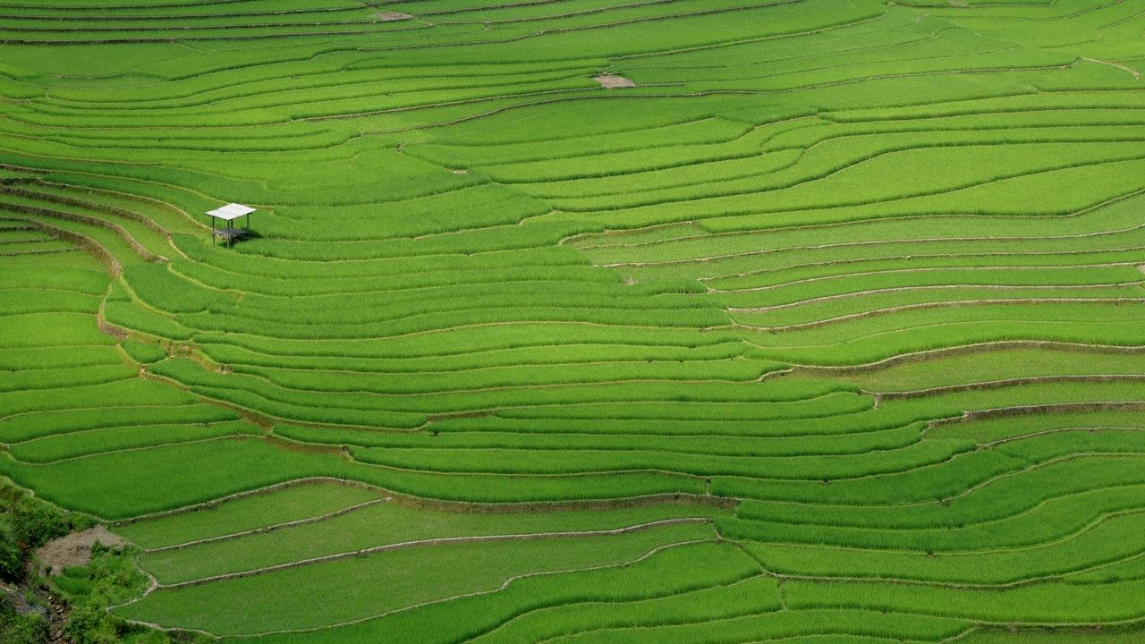
Kishan Bandhu

Slide 2

1.
What is Kishan Bandhu?

Slide 3
In two or three columns
Yellow
Is the color of gold, butter and ripe lemons. In the spectrum of visible light, yellow is found between green and orange.
Blue
Is the colour of the clear sky and the deep sea. It is located between violet and green on the optical spectrum.
Red
Is the color of blood, and because of this it has historically been associated with sacrifice, danger and courage.

Slide 4
2.
Benefits

Slide 5
Benefits:
Farmers can have their desired land.
Farmers can lease/buy machinery.
Easy transaction between stake holders.

Slide 6
3.
Technology Stack

Slide 7
Technology stack
Frontend
HTML 5 – To design the website
CSS 3 – Style the website
Bootstrap 4 – Making website responsive
JS – Adding dynamics to website.
Jquery – HTML DOM, css animation, event handling
Backend
PHP – For all server-side scripting

Slide 8
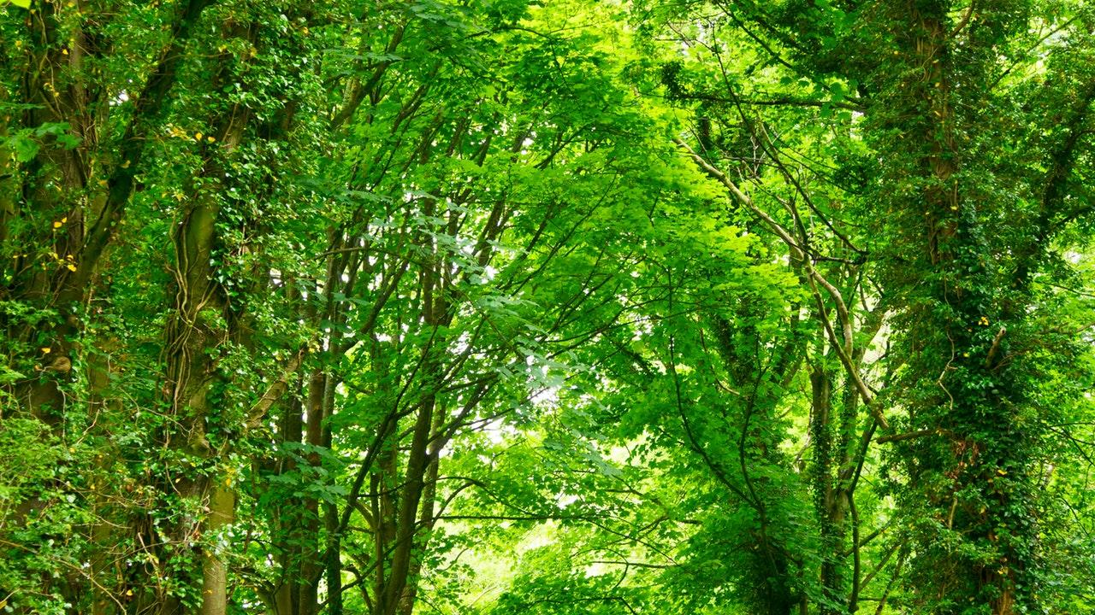
Technology stack
Database
MySql – For relational database queries
Version Control
Git – For distributed version-control system for tracking changes in source code during website development.
Hosting
Amazon Web Service(EC2 instance) – For deploying a virtual machine along with server for hosting.

